Slide 1
Building loosely-coupled Apps with Windows Azure Service Bus Topics and Queues
Name
Title
Microsoft Corporation

Slide 2
Agenda
Messaging
Messaging In Service Bus
One more thing…

Slide 3
Windows Azure Service Bus
Connectivity
Service Relay
Protocol Tunnel
Eventing, Push
Messaging
Queuing
Pub/Sub
Reliable Transfer
Service Management Naming, Discovery
Monitoring
Integration
Routing
Coordination
Transformation
?
Rich options for interconnecting apps across network boundaries
Reliable, transaction-aware cloud messaging infrastructure for business apps
Consistent management surface and service observation capabilities
Content-based routing, document transformation, and process coordination

Slide 4
Windows Azure Service Bus
Connectivity
Service Relay
Protocol Tunnel
Eventing, Push
Messaging
Queuing
Pub/Sub
Reliable Transfer
Service Management Naming, Discovery
Monitoring
Integration
Routing
Coordination
Transformation
?
Rich options for interconnecting apps across network boundaries
Reliable, transaction-aware cloud messaging infrastructure for business apps
Consistent management surface and service observation capabilities
Content-based routing, document transformation, and process coordination

Slide 5
Service Bus Relay
Integrated w/ WCF programming model
Using Outbound Connections Only
No open inbound firewall/NAT ports
Outbound connections default to TCP
Fall back to HTTP when needed
Guarded by Datacenter Firewall
Secured with Access Control
Service Bus
Frontend Nodes
Frontend Nodes
Ctrl
NLB
Forwarder
Ctrl
outbound socket connect
outbound socket rendezvous
Sender
Receiver
4

Slide 6
REST Across The Firewall
demo

Slide 7
Windows Azure Service Bus
Connectivity
Service Relay
Protocol Tunnel
Eventing, Push
Messaging
Queuing
Pub/Sub
Reliable Transfer
Service Management Naming, Discovery
Monitoring
Integration
Routing
Coordination
Transformation
?
Rich options for interconnecting apps across network boundaries
Reliable, transaction-aware cloud messaging infrastructure for business apps
Consistent management surface and service observation capabilities
Content-based routing, document transformation, and process coordination

Slide 8
Messaging

Slide 9
Intermediaries and Brokers
S
AuthN/Z
Intermediary
Backpressure Feedback
R
Route
Intermediaries route messages ‘straight through’ with feedback path and network backpressure into sender
S
Broker
R
AuthN/Z
Query Filter
Pull
Brokers hold messages for retrieval and querying

Slide 10
Push vs. Pull
S
Intermediary
R
‘Push’ is a sender initiated activity that results in delivery of a message to a receiver without the receiver explicitly asking for one or a particular message.
S
Broker
R
‘Pull’ is a receiver initiated activity that delivers stored messages to the receiver in a context that the receiver controls. The context is decoupled from the ‘Push’ style send operation.

Slide 11
Ways to Pull
Receive and Delete
Fastest. Message lost if receiver crashes or transmission fails.
Peek Lock
Message is locked when retrieved. Reappears on broker when not deleted within lock timeout.
Transactional
Local model
Broker
R
Receive and Delete
1. Peek/Lock
R
Broker
2. Delete/Unlock
Broker
R
Receive
Tx

Slide 12
Messages
Brokered messaging properties are not SOAP headers
Properties are key/value pairs that may very well carry payloads
It’s not uncommon to have messages with empty message bodies
Message bodies are useful for a single opaque payload not exposed to the broker (e.g. encrypted content)
Broker Message
Properties
Key
Value
Key
Value
Key
Value
Key
Value
Body
Body

Slide 13
Brokered Messaging Entities: Queues
S
Queue
R
Sequential Message Log
Competing Consumers
Shared Cursors and Locks over the log

Slide 14
Brokered Messaging Entities: Topics
S
Sub
R
Topic
Sub
Sub
Sequential Message Log
Multiple subscribers over the log, each with own cur/locks
Subscribers can filter with expressions on properties
Competing Consumers on each subscription

Slide 15
aKite
partner

Slide 16

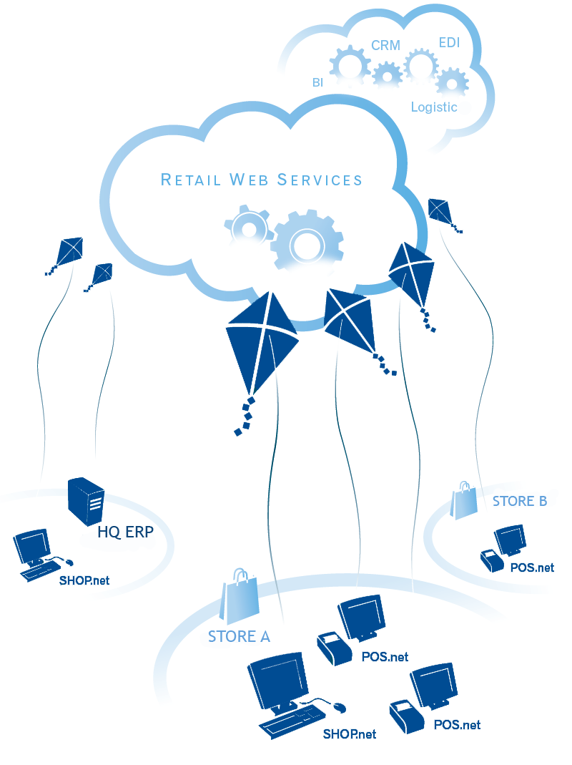
aKite: Retail Management on Azure
POS and In-Store SaaS
Retail Web Services
POS.net & SHOP.net
Connects Stores
to HQ & to the World
Removes
Complexity & Servers
Save energy & the Planet
LIVE since Azure Day 1

Slide 17
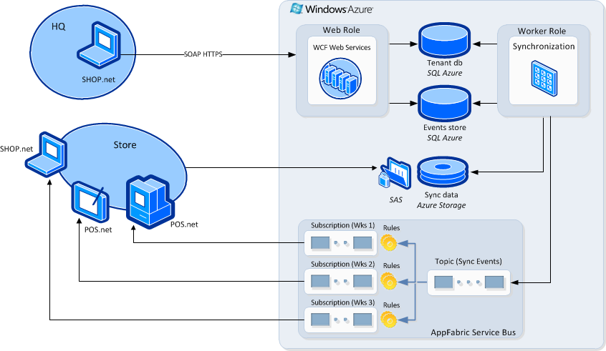
aKite Refreshed Architecture

Slide 18
Price update in a chain of stores
demo

Slide 19
Benefits of Refreshed Architecture with Service Bus Topics
Simpler architecture
Reduced load on Web Roles and SQL Azure
Push-based notification to clients
Saved 62% web services calls (15% CPU time)
Less infrastructure code required
Service Bus handles event notification
aKite Retail Web Services focused on business relevant functions
aKite scales better!

Slide 20

aKite = Windows Azure + Service Bus

Slide 21
Messaging In Service Bus

Slide 22
Hello World!
var tkp = TokenProvider.CreateSharedSecretTokenProvider("acct", "…");
var svcUri = ServiceBusEnvironment.CreateServiceUri("sb", "myns", "");
var nsm = new NamespaceManager(svcUri, tkp);
nsm.CreateQueue(queueName);
var mf = MessagingFactory.Create(svcUri, tkp);
var qc = mf.CreateQueueClient(queueName);
qc.Send(new BrokeredMessage { Properties = {{ "Greeting", "Hello World!" }}});
var m = qc.Receive();
Console.WriteLine(m.Properties["Greeting"]);
1
2
3

Slide 23
NamespaceManager Management operations on the namespace Create/Delete/Exists for Queues, Topics, and Subscriptions
var tkp = TokenProvider.CreateSharedSecretTokenProvider("acct", "…");
var svcUri = ServiceBusEnvironment.CreateServiceUri("sb", "myns", "");
var nsm = new NamespaceManager(svcUri, tkp);
if (!nsm.QueueExists(queueName))
{
nsm.CreateQueue(queueName);
}
nsm.DeleteQueue(queueName);
var topic = nms.CreateTopic("IssueTrackingTopic");
var auditSub = nms.CreateSubscription(topic.Path, "AuditSubscription");
var agentSub = nms.CreateSubscription(topic.Path, "AgentSubscription");
1
2
3
4

Slide 24
MessagingFactory Creates client objects to interact with Queues, Topics, and Subscriptions. Anchor for connection management and multiplexing.
var tkp = TokenProvider.CreateSharedSecretTokenProvider("acct", "…");
var svcUri = ServiceBusEnvironment.CreateServiceUri("sb", "myns", "");
var factory = MessagingFactory.Create(svcUri, tkp);
var queueClient = factory.CreateQueueClient(queueName);
queueClient.Send(message);
var sender = factory.CreateMessageSender(queueName);
sender.Send(message);
var subClient = factory.CreateSubscriptionClient("mytopic", "mysub", ReceiveMode.ReceiveAndDelete);
subClient.Receive();
1
2
3
4

Slide 25
BrokeredMessage
var bm = new BrokeredMessage
{
TimeToLive = TimeSpan.FromMinutes(30),
ReplyTo = “sb://clemensv.servicebus.windows.net/replyqueues/1",
Properties = {
{ "JobId", 1 },
{ "SubmittedAt", DateTime.UtcNow },
{ "JobData", "..." }
}
};
var jobDetail = new JobDetail();
var bm = new BrokeredMessage(jobDetail);
var bm = new BrokeredMessage(utf8EncodedTextStream)
{
ContentType = "text/plain"
};
1
2
3

Slide 26
Sending Messages Sending messages is done with Send or Begin/EndSend. You can send on the QueueClient or TopicClient or the neutral MessageSender.
var queueClient = factory.CreateQueueClient(queueName);
queueClient.Send(message);
queueClient.BeginSend(message, DoneSending, queueClient);
void DoneSending(IAsyncResult ar)
{
var queueClient = (QueueClient)ar.AsyncState;
queueClient.EndSend(ar);
} var sender = factory.CreateMessageSender(queueName);
sender.Send(message);
1
2
3

Slide 27
Receiving Messages (Destructive) Destructive receives remove the messages from the queue as it is being taken from the broker. Higher throughput than Peek/Lock, but risk of message loss.
var queueClient = factory.CreateQueueClient(queueName, ReceiveMode.ReceiveAndDelete);
var message = queueClient.Receive(TimeSpan.FromMinutes(1)); if ( message != null ) {
…
queueClient.BeginReceive(TimeSpan.FromMinutes(1), DoneReceiving, queueClient);
void DoneReceiving(IAsyncResult ar)
{
var queueClient = (QueueClient)ar.AsyncState;
var message = queueClient.EndReceive(ar);
if ( message != null ) {
…
1
2

Slide 28
Receiving Messages (Peek/Lock) Peek/lock returns messages that have been locked on the queue in the broker. Locked messages are invisible. Complete() deletes them, Abandon() puts them back.
var queueClient = factory.CreateQueueClient(queueName, ReceiveMode.PeekLock);
var message = queueClient.Receive(TimeSpan.FromMinutes(1)); if ( message != null ) {
Try
{ .. processing work ..
message.Complete();
}
Catch
{
message.Abandon();
throw;
}
1

Slide 29
Queue Patterns
S
Queue
R
Load Leveling
Receiver receives and processes at its own pace. Can never be overloaded. Can add receivers as queue length grows, reduce receiver if queue length is low or zero. Gracefully handles traffic spikes by never stressing out the backend.
Offline/Batch
Allows taking the receiver offline for servicing or other reasons. Requests are buffered up until the receiver is available again.

Slide 30
Competing Consumer
R
S
Queue
R
R
Load Balancing
Multiple receivers compete for messages on the same queue (or subscription). Provides automatic load balancing of work to receivers volunteering for jobs.
Observing the queue length allows to determine whether more receivers are required.

Slide 31
Managing Topics Management operations on the namespace Create/Delete/Exists for Queues, Topics, and Subscriptions
var tkp = TokenProvider.CreateSharedSecretTokenProvider("acct", "…");
var svcUri = ServiceBusEnvironment.CreateServiceUri("sb", "myns", "");
var nsm = new NamespaceManager(svcUri, tkp);
var topic = nms.CreateTopic("IssueTrackingTopic");
nms.CreateSubscription(topic.Path, "AuditSubscription", new TrueFilter());
nms.CreateSubscription(topic.Path, "BlindTap", new FalseFilter());
nms.CreateSubscription(topic.Path, "USAgentSubscription", new SqlFilter("ShipCountry = 'US'"));
nms.CreateSubscription(topic.Path, "DEAgentSubscription", new SqlFilter("ShipCountry = 'DE'"));
nms.CreateSubscription(new SubscriptionDescription(topic.Path, "CNAgentSubscription")
{
EnableDeadLetteringOnMessageExpiration = true
}, new SqlFilter("ShipCountry = 'CN'"));
1
2
3

Slide 32
Receiving Messages
var subClient =
factory.CreateSubscriptionClient(topicName, subName, ReceiveMode.ReceiveAndDelete);
var message = subClient.Receive(TimeSpan.FromMinutes(1)); if ( message != null ) {
…
var rcv = factory.CreateMessageReceiver( SubscriptionClient.FormatSubscriptionPath(topicName, subName), ReceiveMode.ReceiveAndDelete);
var message = rcv.Receive(TimeSpan.FromMinutes(1)); if ( message != null ) {
…
1
2

Slide 33
Filters
Filter conditions operate on message properties and are expressed in SQL’92 syntax
InvoiceTotal > 10000.00 OR ClientRating <3
ShipDestCtry = ‘USA’ AND ShipDestState=‘WA’
LastName LIKE ‘V%’
Filters actions may modify/add/remove properties as message is selected
SET AuditRequired = 1

Slide 34
Why Topics?
R
R
S
Sub
R
Topic
R
Sub
Sub
R
Message Distribution
Each receiver gets its own copy of each message. Subscriptions are independent. Allows for many independent ‘taps’ into a message stream. Subscriber can filter down by interest.
Constrained Message Distribution (Partitioning)
Receiver get mutually exclusive slices of the message stream by creating appropriate filter expressions.

Slide 35
Continuous Client with Topics
demo

Slide 36
A Quick Tour through the SDK Samples
demo

Slide 37
Summary
Messaging provides a wholly new capability set for Service Bus
Reliable message transfer
Temporal decoupling, load balancing and leveling
Ordered processing, session multiplexing
etc. etc. etc.
…want more? 2 more hours of fresh content on Channel 9:
“Session 862A” – Service Bus Advanced Patterns and Guidance
“Session 862B” – Service Bus Authorization with ACS

